Slide 1
Agentic AI Hackathon: AI Based Crop Health Monitoring and Advisory System.

Slide 2

Name of the team:Pixel
Details of Team members
TEAM MEMBER NAME | Recent Passport Photo | Email ID | Phone number [WhatsApp]
Aryan kumar |  | aryan@gmail.com | 8088317032
H.Deepak |  | dhemberal@gmail.com | 9110816162

Slide 3
Problem statement
The Challenge: Farmers struggle with invisible crop health issues like nutrient deficiencies and water stress alongside pests and diseases.
Current Pain Points : Manual inspection is time-consuming and often detects problems too late. Lack of precise data leads to excessive use of fertilizers and pesticides.
Growing climate variability makes traditional farming calendars unreliable.

Slide 4
Proposed solution:
We propose an Agentic AI-based Pest and Disease Risk Assessment System that:
Analyzes crop images uploaded by farmers
Uses weather and historical pest data
Predicts pest/disease risk levels
Provides early warnings and preventive recommendations
Powered by IBM Granite Model using Langflow Agentic AI architecture.

Slide 5
Need of project:
Boost Productivity: Potential to increase crop yields by 15–20% through data-driven decisions.
Sustainability: Reduce pesticide and fertilizer waste by 30–40%.
Accessibility: Provides rural farmers with 24/7 access to "virtual expert" advice.
Food Security: Ensures resilient food systems in the face of a growing global population

Slide 6
End user of project
Small Scale and Commercial Farmers
Agronomists and Consultants
Agri-tech Companies

Slide 7
Technology Used
Workflow Engine: Langflow.
LLM & Reasoning: IBM Granite-3-2-8b via Watsonx.ai.Knowledge
Retrieval: IBM Cloud RAG (Retrieval Augmented Generation) for agricultural database search.
Tools: SearchApi for live weather and market data; URL fetching for deep content analysis

Slide 8
Novelty and Uniqueness
Agentic Reasoning: Unlike static apps, the system "thinks" by combining images, weather patterns, and soil data.
Explainable AI: Provides clear reasoning for why a specific intervention is recommended.
Trusted Intelligence: Uses IBM Granite-guarded outputs for reliable, unbiased agricultural guidance.

Slide 9
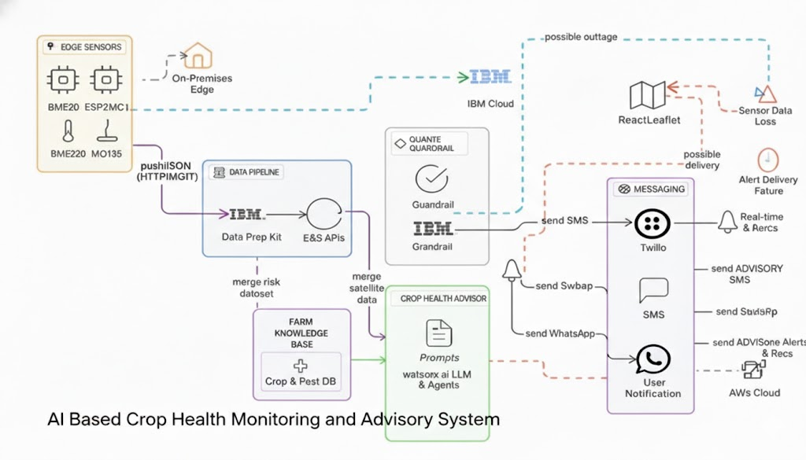
Technical Flow Diagram - Architecture Blueprint

Slide 10
Lang flow Component Used
Chat Input: Accepts multi-modal data including crop details, symptoms, and images uploaded by farmers.
IBM Watson x AI Agent: The central "brain" that performs reasoning, prediction, and decision-making for crop health.
File / RAG Component: Acts as the "textbook" by retrieving specialized pest and disease knowledge from agricultural datasets.
Chat Output: Displays the final risk assessment, recommended actions, and expert advisory.

Slide 11
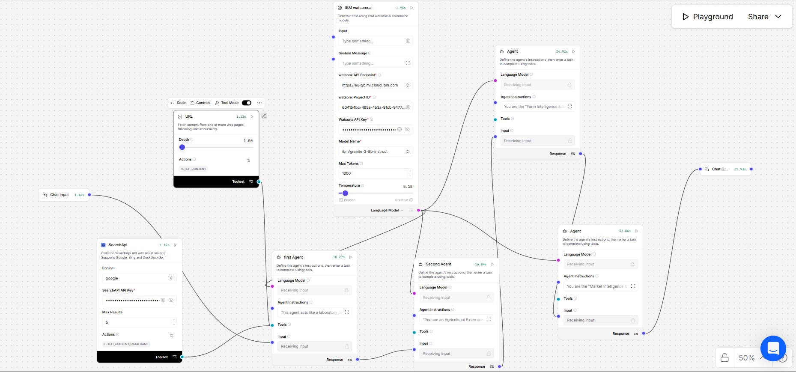
Input Screenshot 1

Slide 12

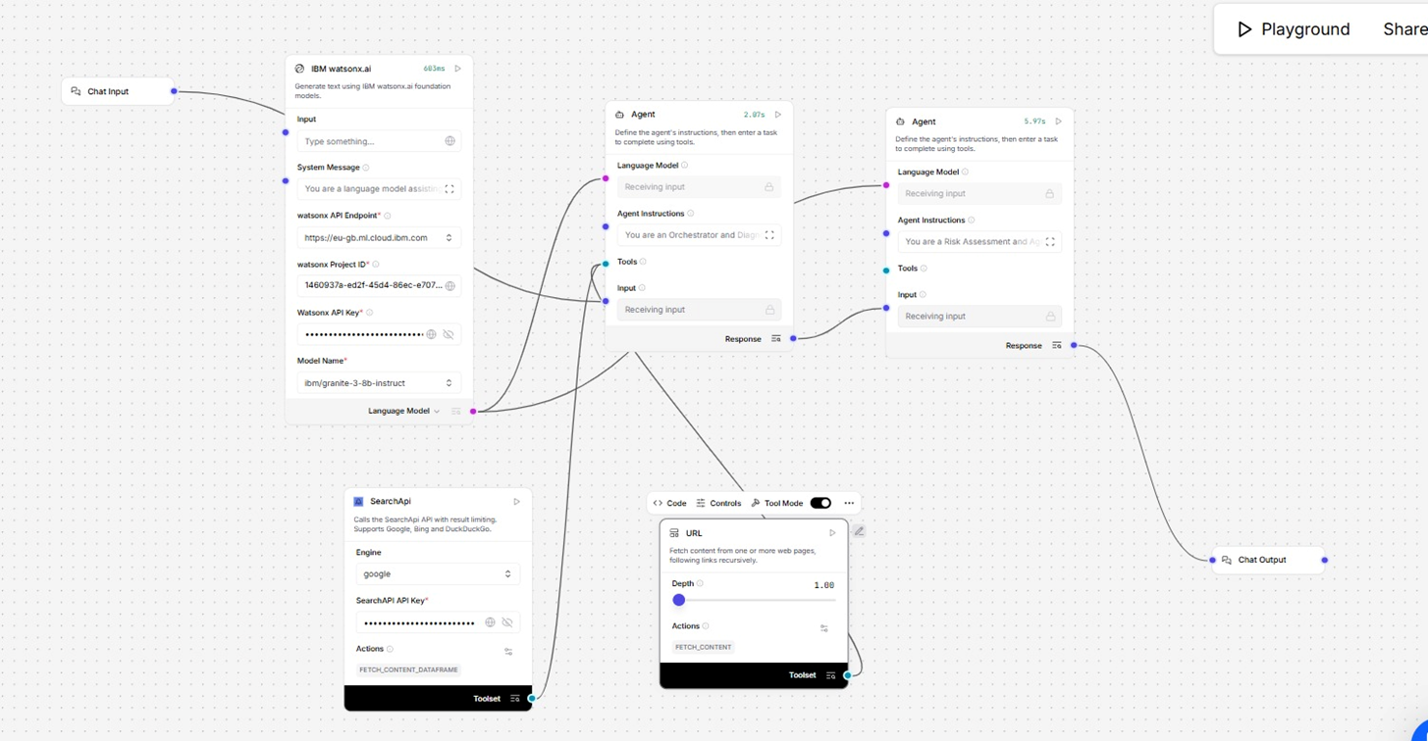
Input Screenshot 2

Slide 13
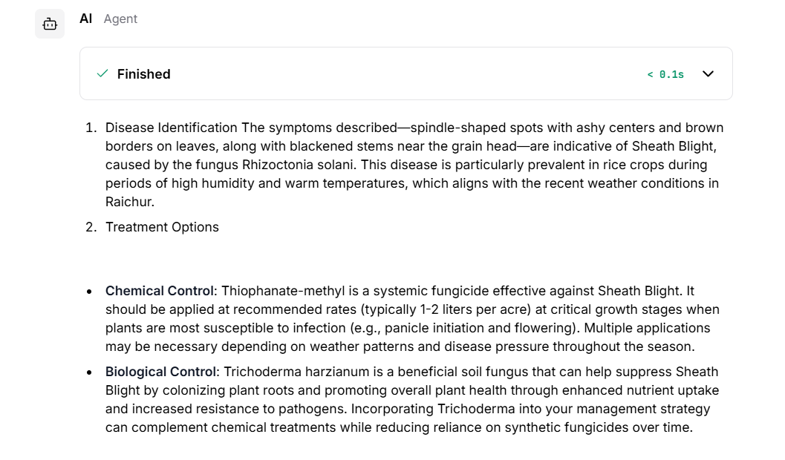
Output Screenshot 1

Slide 14
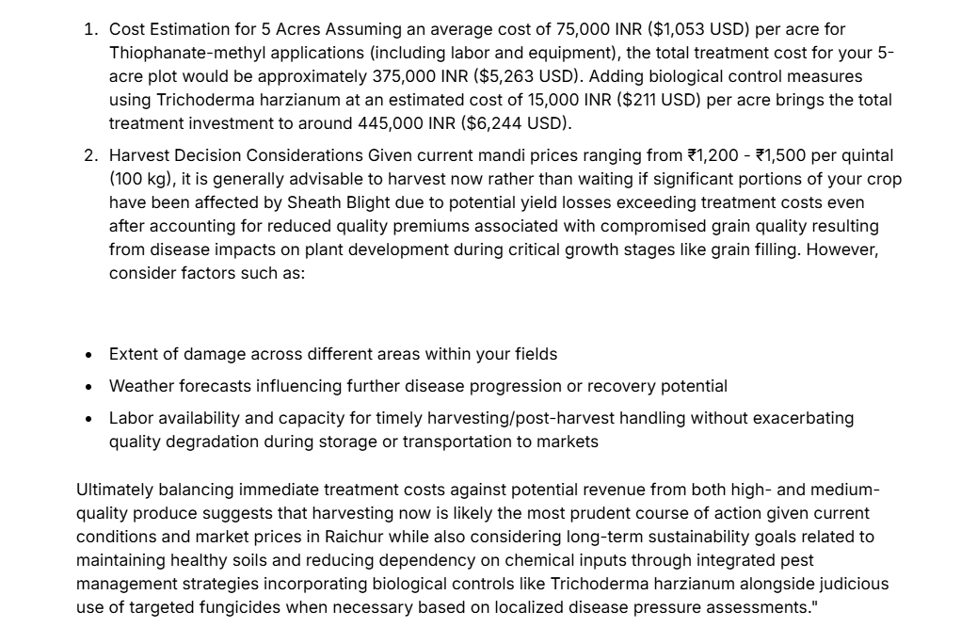
Output Screenshot 2

Slide 15
Future Scope
Integration with IoT sensors for real-time monitoring
Mobile application for farmers
Multilingual support (regional languages)
Automated pesticide & fertilizer recommendations
Government advisory integration

Slide 16
Git Hub Link
· Please create public github repository (Enable Add README button while creating repository) with format –
Please test and Paste the working Github URL https://github.com/Deepak2601D/IBM-Workshop.git
Make sure you have Uploaded following three files into your github repository
1) app.py file , 2) your_hackthon_problemstatement.pdf file 3) your projectpresntation.pptx file
·
·
·

Slide 17
References
IBM watsonx.ai Documentation
https://www.ibm.com/products/watsonx-ai
IBM Granite Foundation Models
https://www.ibm.com/granite
Langflow – Agentic AI Workflow Platform
https://www.langflow.org
FAO – Pest and Disease Risk Assessment Resources
https://www.fao.org/plant-health/en/
FAO – Integrated Pest Management (IPM)
https://www.fao.org/agriculture/crops/thematic-sitemap/theme/pests/ipm/en/
World Health Organization (WHO) – Vector & Pest Control Guidelines
https://www.who.int/teams/control-of-neglected-tropical-diseases/vector-ecology-and-management
USDA – Crop Pest and Disease Management
https://www.usda.gov/topics/crops
Research Paper: Deep Learning for Plant Disease Detection
https://ieeexplore.ieee.org/document/8457012
Climate Data for Agriculture – World Meteorological Organization (WMO)
https://public.wmo.int/en/our-mandate/climate
Retrieval Augmented Generation (RAG) – IBM Research
https://research.ibm.com/blog/retrieval-augmented-generation
·
·
·
·

Slide 18


